Slide 1

Modeling Long Sequences with Efficient Transformers
汤斯亮（Siliang Tang）
siliang@zju.edu.cn

Slide 2
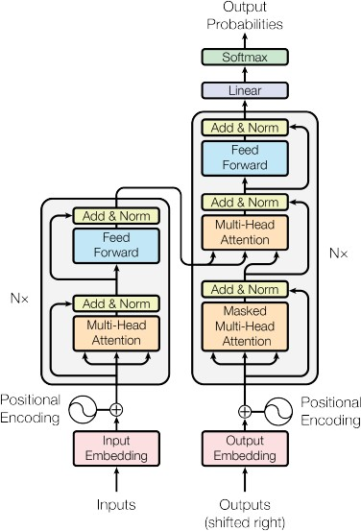














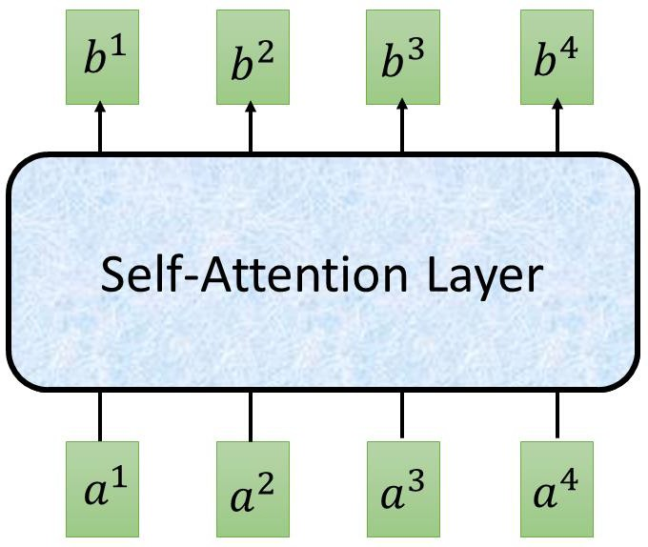
Transformer
Layer Norm:
https://arxiv.org/
abs/1607.06450
Batch Norm:
https://www.yout ube.com/watch?v
=BZh1ltr5Rkg
Batch Size
_{𝑏}′
Layer
Norm
𝜇 = 0,
𝜎 = 1
Batch
+
𝑏
𝜇 = 0, 𝜎 = 1
Layer
…
𝑎
attend on the
input sequence
Masked: attend on the generated sequence

Slide 3
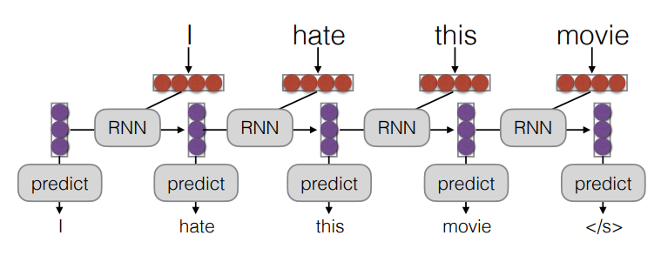
Document Level Language Modeling
We want to predict the probability of words in an entire document.
Sentences in a document don’t exist in a vacuum!
Modeling with Recurrent Networks : pass previous information in hidden state

Slide 4
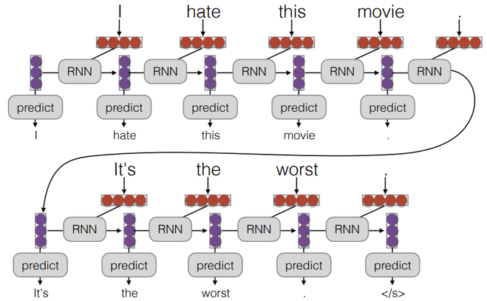
Documents Level Language Modeling
A Simple Idea : Infinitely Pass State

Slide 5
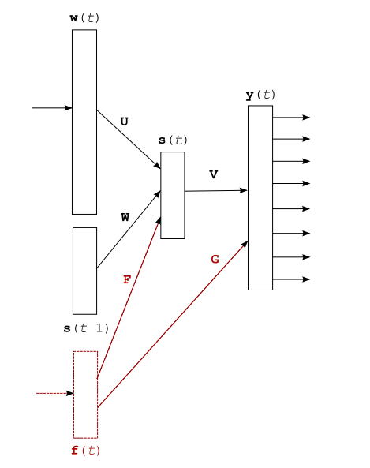
Documents Level Language Modeling
Separate Encoding for Coarse-grained Document Context
One big RNN for local and global context tends to miss out on global context (as local context is more predictive)
Provide a contextual real-valued input vector in association with each word.
www.microsoft.com/en-us/research/wp-content/uploads/2016/02/rnn_ctxt.pdf

Slide 6
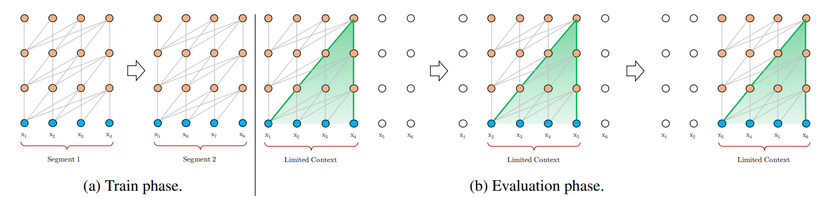
Documents Level Language Modeling
Transformer-XL : Truncated BPTT + Transformer
Idea: attend to fixed vectors from the previous sentence
Like truncated backprop through time for RNNs：can use previous states, but not backprop into them
Vanilla Transformer (with a segment length 4)
arxiv.org/pdf/1901.02860.pdf

Slide 7
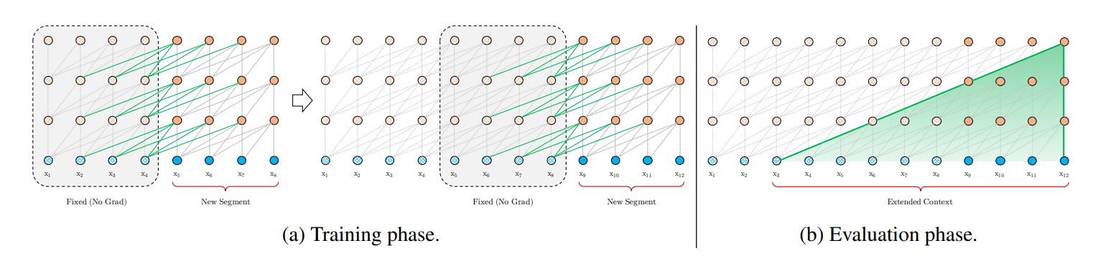
Documents Level Language Modeling
Transformer-XL : Truncated BPTT + Transformer
Idea: attend to fixed vectors from the previous sentence
Like truncated backprop through time for RNNs：can use previous states, but not backprop into them
Transformer-XL (with a segment length 4)
arxiv.org/pdf/1901.02860.pdf

Slide 8
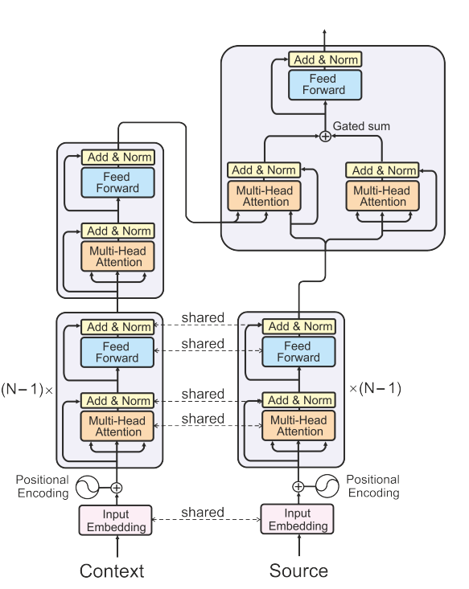
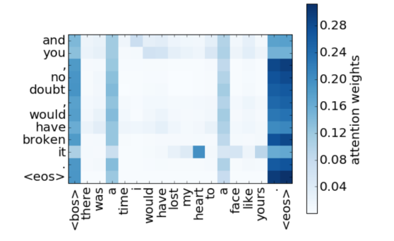
Documents Level Language Modeling
Self-attention / Transformers Across Sentences
Simply self-attend to all previous words in the document
+ Can relatively simply use document-level context
+ Can learn interesting phenomena (e.g. co-reference)
- Computation is quadratic in sequence length!
arxiv.org/pdf/1805.10163.pdf

Slide 9


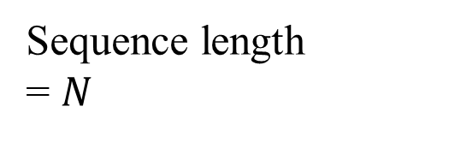

How to make self-attention efficient?
key
Sequence length
= $N$
$$N$$
$$N$$
query
Attention Matrix
$$N×N$$

Slide 10
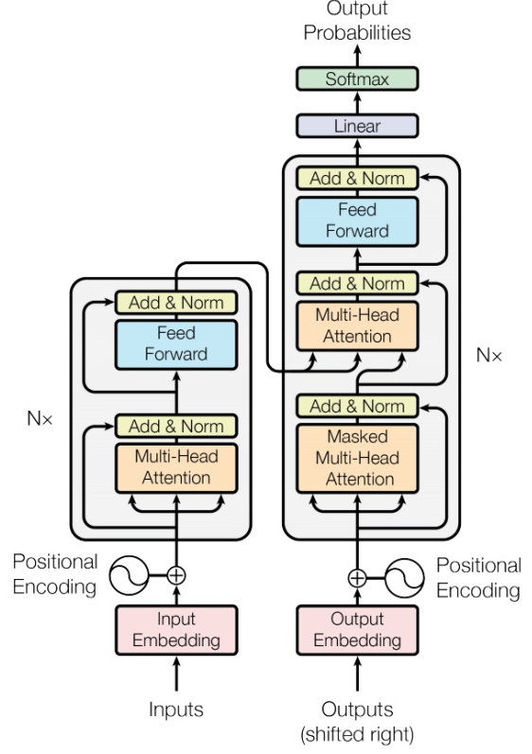
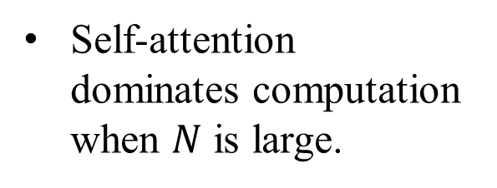


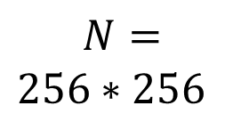
Efficient Transformers
Notice
Self-attention is only a module in a larger network.
Self-attention dominates computation when $N$ is large.
Usually developed for image processing
$$N=$$
$256∗256$
$$256$$
$$256$$

Slide 11
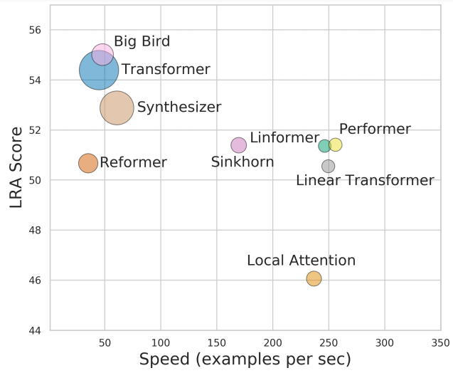
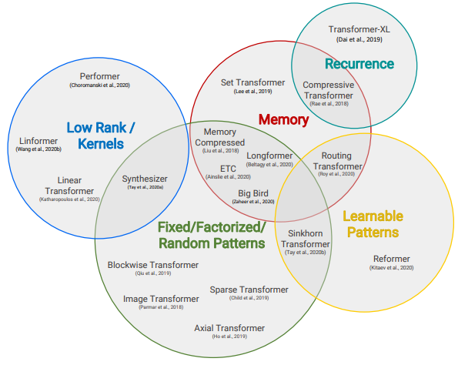
Efficient Transformers
Long Range Arena: A Benchmark for Efficient Transformers
https://arxiv.org/abs/2011.04006
Efficient Transformers: A Survey
https://arxiv.org/abs/2009.06732
Notes:
Arena 競技場

Slide 12
Efficient Transformers
Sparse Attention
Heuristic
Local Attention, Big Bird, and etc.
Clustering
Reformer, and etc.
Learnable
Sinkhorn, and etc.
Representative key
Linformer, and etc.
Others
Attention approximation
Linear Transformer, Performer, and etc.
Attention free framework
Synthesizer and etc.

Slide 13
Skip Some Calculations with Human Knowledge
Can we fill in some values with human knowledge?
Notes:
Examples of models that do this include Blockwise (Qiu et al., 2019) and/or Local Attention (Parmar et al., 2018).

Slide 14
Local Attention / Truncated Attention
Set to 0
……
query
Similar with CNN
Calculate attention weight
key
Notes:
Examples of models that do this include Blockwise (Qiu et al., 2019) and/or Local Attention (Parmar et al., 2018).

Slide 15
Stride Attention
…
…
Notes:
Strided Patterns
Models such as Sparse Transformer (Child et al., 2019) and/or Longformer (Beltagy et al., 2020) employ strided or “dilated” windows.

Slide 16
Global Attention
Add special token into original sequence
Attend to every token $→$ collect global information
Attended by every token $→$ it knows global information
…
No attention between non-special token
…
Notes:
- Another prominent method is to leverage a side memory module that can access multiple tokens at once.
Global memory is also used in ETC (Ainslie et al., 2020) and Longformer (Beltagy et al., 2020).

Slide 17
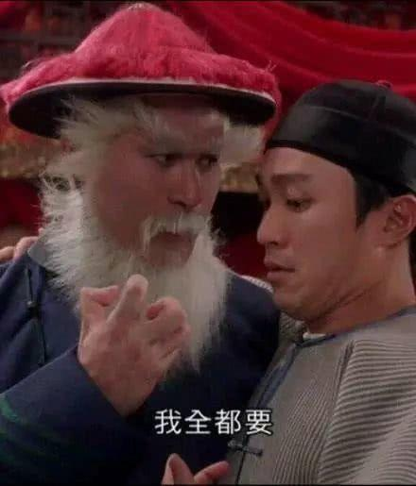
Many Different Choices …
小孩子才做选择．．．
Different heads use different patterns.
Notes:
Combination of Patterns
The key idea of combined1 approaches is to improve coverage by combining two or more distinct access patterns. For example, the Sparse Transformer (Child et al., 2019) combines strided and local attention by assigning half of its heads to pattern

Slide 18
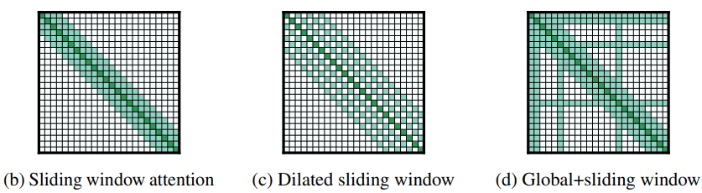
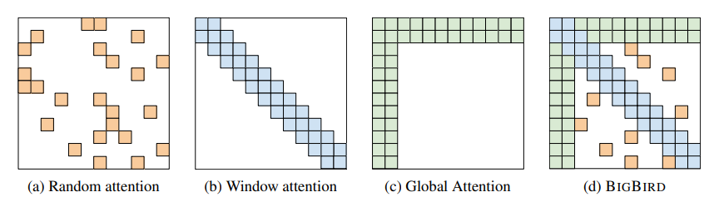
Many Different Choices …
https://arxiv.org/abs/2004.05150
Longformer
Big Bird
https://arxiv.org/abs/2007.14062
Notes:
Sparse
Block Transformer
The key idea of combined1 approaches is to improve coverage by combining two or more distinct access patterns. For example, the Sparse Transformer (Child et al., 2019) combines strided and local attention by assigning half of its heads to pattern

Slide 19
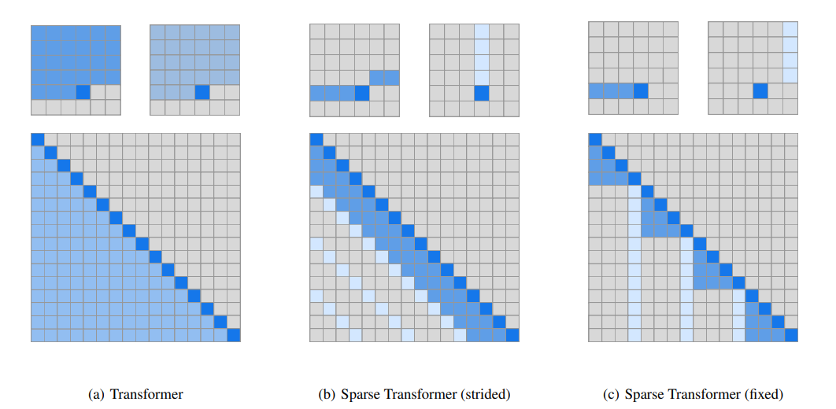
Sparse Transformers
Add "stride", only attending to every n previous states
arxiv.org/pdf/1904.10509.pdf

Slide 20
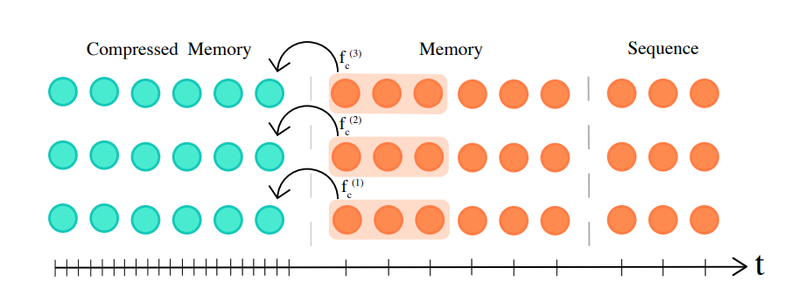
Compressive Transformers
Add a "strided" compression step over previous states
arxiv.org/pdf/1911.05507.pdf

Slide 21
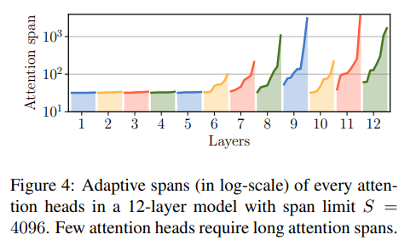
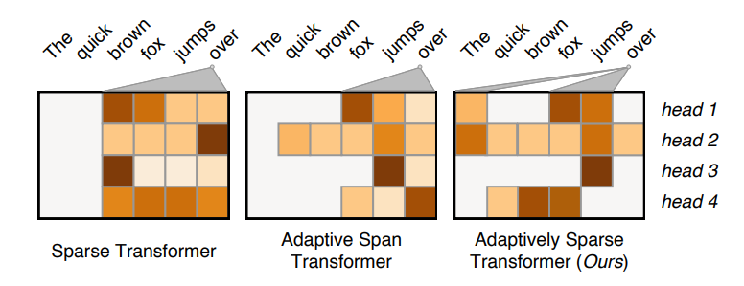
Adaptive Span Transformers
Each self-attention layer learns its optimal context size, resulting in a network where attention layer gathers information on their own context.
Can be further combined with sparse computation!
arxiv.org/pdf/1905.07799.pdf
arxiv.org/pdf/1909.00015.pdf

Slide 22
Efficient Transformers
Sparse Attention
Heuristic
Local Attention, Big Bird, and etc.
Clustering
Reformer, and etc.
Learnable
Sinkhorn, and etc.
Representative key
Linformer, and etc.
Others
Attention approximation
Linear Transformer, Performer, and etc.
Attention free framework
Synthesizer and etc.

Slide 23
Can we only focus on Critical Parts?
key
small value
Directly set to 0
query
Smaller influence on results
large value
How to quickly estimate the portion with small attention weights?

Slide 24
Clustering
Reformer
https://openreview.net/forum?id=rkgNKkHtvB
Routing Transformer
Step 1
https://arxiv.org/abs/2003.05997
query
key
Clustering
based on similarity
(approximate & fast)
1
4
1
2
3
3
3
2
2
1
3
3
1
4
1
4
Notes:
Reformer (Kitaev et al., 2020) introduces a hash-based similarity measure to efficiently cluster tokens into chunks.
Routing Transformer (Roy et al., 2020) employs online k-means clustering on the tokens.

Slide 25
Clustering
key
Step 2
query
Belong to the same cluster, then calculate attention weight
Not the same cluster, set to 0
Notes:
Our strategy first assigns queries and keys to clusters. Then only queries and keys from the same cluster are considered for attention.
In other words, the current time-step query is routed to a limited number of context elements through its cluster assignment.
===
Reformer (Kitaev et al., 2020) introduces a hash-based similarity measure to efficiently cluster tokens into chunks.
Routing Transformer (Roy et al., 2020) employs online k-means clustering on the tokens.

Slide 26
Efficient Transformers
Sparse Attention
Heuristic
Local Attention, Big Bird, and etc.
Clustering
Reformer, and etc.
Learnable
Sinkhorn, and etc.
Representative key
Linformer, and etc.
Others
Attention approximation
Linear Transformer, Performer, and etc.
Attention free framework
Synthesizer and etc.

Slide 27
Learnable Patterns
https://arxiv.org/abs/2002.11296
Input sequence
Sinkhorn Sorting Network
key
NN
Jointly learned
query
A grid should be skipped or not is decided by another learned module
(simplified version)
Notes:
Sinkhorn Sorting Network (Tay et al., 2020b) exposes the sparsity in attention weights by learning to to sort blocks of the input sequence
instead of attending to tokens in the same block, each token attends to tokens in the newly sorted block,

Slide 28
Efficient Transformers
Sparse Attention
Heuristic
Local Attention, Big Bird, and etc.
Clustering
Reformer, and etc.
Learnable
Sinkhorn, and etc.
Representative key
Linformer, and etc.
Others
Attention approximation
Linear Transformer, Performer, and etc.
Attention free framework
Synthesizer and etc.

Slide 29
Do we need full attention matrix?
Linformer
https://arxiv.org/abs/2006.04768
Many redundant columns
query
key
Low Rank
Notes:
Another emerging technique is to improve efficiency by leveraging low-rank approximations of the self-attention matrix
The usage of kernels (Katharopoulos et al., 2020; Choromanski et al., 2020) enable clever mathematical re-writing of the self-attention mechanism to avoid explicitly computing the N × N matrix.
=====
self-attention is low rank:
The right figure plots the heatmap of normalized cumulative eigenvalue at the 128-th largest eigenvalue across different layers and heads in Wiki103 data. (n=512)

Slide 30




$$N$$
$$N$$
value
key
Representative keys
$$K$$
$$K$$
output
Can we reduce the number of queries?
query
change output sequence length

Slide 31






Reduce Number of Keys
Compressed Attention
Linformer
https://arxiv.org/abs/1801.10198
https://arxiv.org/abs/2006.04768
$$N$$
$$d$$
Conv
Conv
Conv
Conv
$$N×K$$
$$d$$
Linear combination of $N$ vectors
$$K$$
Notes:
只有幾種ｖａｌｕｅ，只有幾種qeruy
Cannot do causula masking
Funnel (漏斗) transformer -> signore this

Slide 32
Efficient Transformers
Sparse Attention
Heuristic
Local Attention, Big Bird, and etc.
Clustering
Reformer, and etc.
Learnable
Sinkhorn, and etc.
Representative key
Linformer, and etc.
Others
Attention approximation
Linear Transformer, Performer, and etc.
Attention free framework
Synthesizer and etc.

Slide 33
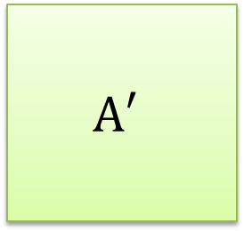










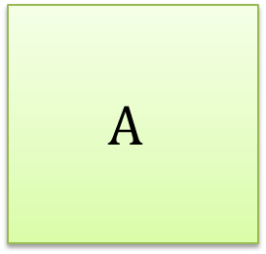







Attention Mechanism is three-matrix Multiplication
Review
$$Q$$
$$d×N$$
=
$$I$$
$$W^{q}$$
$$d×N$$
$$K$$
=
$$I$$
$$W^{k}$$
$$d′×N$$
$$V$$
=
$$I$$
$$W^{v}$$
$$A′$$
$$A$$
=
$$Q$$
$$K^{T}$$
softmax
ignore
$$A′$$
$$O$$
=
$$V$$

Slide 34







Attention Mechanism is three-matrix Multiplication
Review
$$Q$$
$$d×N$$
=
$$I$$
$$W^{q}$$
$$d×N$$
$$K$$
=
$$I$$
$$W^{k}$$
$$d′×N$$
$$V$$
=
$$I$$
$$W^{v}$$
$$O$$
$$≈$$
$$V$$
$$Q$$
$$K^{T}$$
$$d′×N$$
$$d′×N$$
$$d×N$$
$$N×d$$

Slide 35
















$$O$$
$$≈$$
$$V$$
$$Q$$
$$K^{T}$$
$$d′×N$$
$$d′×N$$
$$d×N$$
$$N×d$$
$$O$$
$$≈$$
$$V$$
$$Q$$
$$K^{T}$$
$$d′×N$$
$$d′×N$$
$$d×N$$
What is the difference?
$$N×d$$

Slide 36
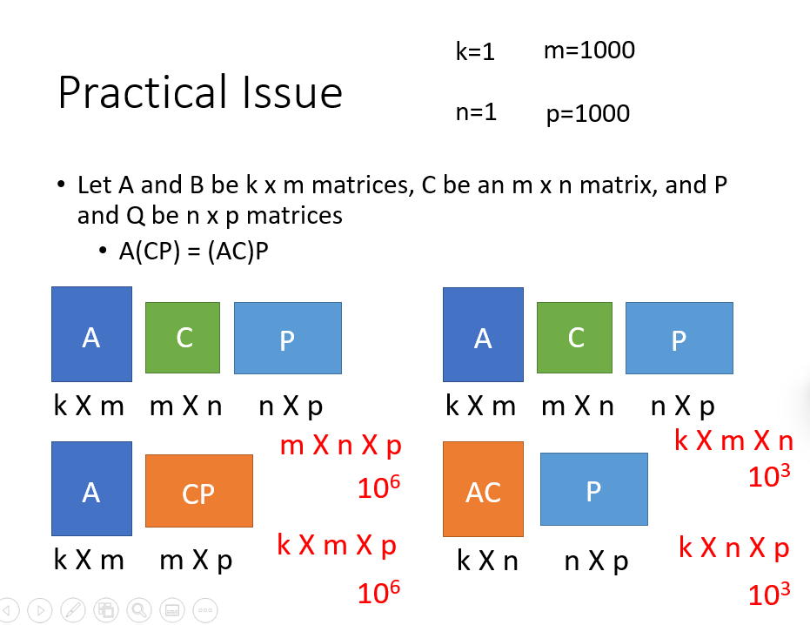
Review Linear Algebra
https://youtu.be/yO8lDzf4jMs

Slide 37


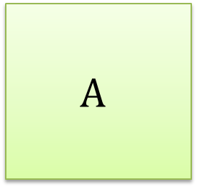




$$O$$
$$≈$$
$$V$$
$$Q$$
$$K^{T}$$
$$\left(d+d′\right)N^{2}$$
$$d′×N$$
$$d′×N$$
$$d×N$$
$$N×d$$
$$N×d×N$$
$$A$$
$$V$$
Attention Matrix
$$d′×N$$
$$N×N$$
$$d′×N×N$$

Slide 38















$$O$$
$$≈$$
$$V$$
$$Q$$
$$K^{T}$$
$${2d}^{′}dN$$
$$d′×N$$
$$d′×N$$
$$d×N$$
$$N×d$$
$$d′×N×d$$
$$d×N$$
$$d′×d$$
$$?$$
$$Q$$
$$d′×d×N$$

Slide 39






$$O$$
$$≈$$
$$V$$
$$Q$$
$$K^{T}$$
$$\left(d+d′\right)N^{2}$$
$$d×N$$
$$d×N$$
$$d×N$$
$$N×d$$
$$>$$
$$O$$
$$≈$$
$$V$$
$$Q$$
$$K^{T}$$
$${2d}^{′}dN$$
$$d×N$$
$$d×N$$
$$d×N$$
$$N×d$$

Slide 40




Realization
Efficient attention
Linear Transformer
Random Feature Attention
Performer
$$exp\left(q∙k\right)≈φ\left(q\right)∙φ\left(k\right)$$
https://arxiv.org/pdf/1812.01243.pdf
https://linear-transformers.com/
$$q$$
$$φ$$
$$φ\left(q\right)$$
https://arxiv.org/pdf/2103.02143.pdf
https://arxiv.org/pdf/2009.14794.pdf

Slide 41
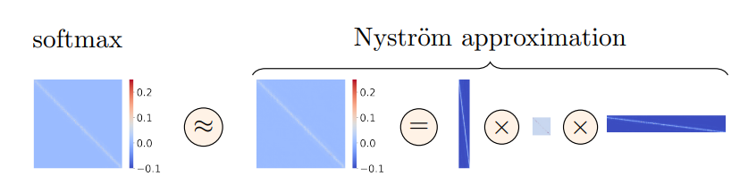
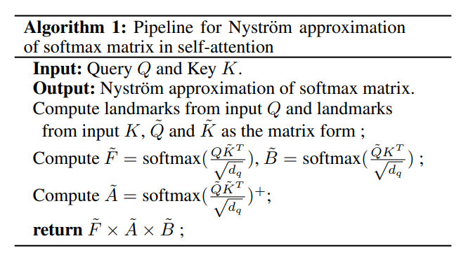
Low-rank Approximation
Calculating the attention matrix is expensive, can it be predicted with a low-rank matrix?
Nystromformer: Approximate using the Nystrom method, sampling "landmark" points
arxiv.org/pdf/2102.03902.pdf

Slide 42
Efficient Transformers
Sparse Attention
Heuristic
Local Attention, Big Bird, and etc.
Clustering
Reformer, and etc.
Learnable
Sinkhorn, and etc.
Representative key
Linformer, and etc.
Others
Attention approximation
Linear Transformer, Performer, and etc.
Attention free framework
Synthesizer and etc.

Slide 43










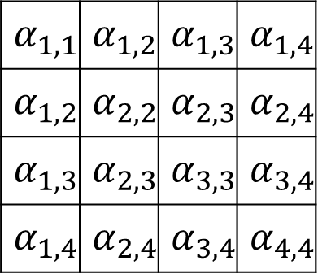



Synthesizer
https://arxiv.org/abs/2005.00743
Do we need q and k to compute attention?
$$b^{1}$$
$$b^{2}$$
$$b^{3}$$
$$b^{4}$$
$$α_{1,1}$$ | $$α_{1,2}$$ | $$α_{1,3}$$ | $$α_{1,4}$$
$$α_{1,2}$$ | $$α_{2,2}$$ | $$α_{2,3}$$ | $$α_{2,4}$$
$$α_{1,3}$$ | $$α_{2,3}$$ | $$α_{3,3}$$ | $$α_{3,4}$$
$$α_{1,4}$$ | $$α_{2,4}$$ | $$α_{3,4}$$ | $$α_{4,4}$$
softmax
$$b^{1}=\sum_{i=1}^{N}{α_{1,i}^{′}v^{i}}$$
From q and k?
$$v^{1}$$
$$v^{2}$$
$$v^{3}$$
$$v^{4}$$
They are network parameters!
$$a^{1}$$
$$a^{2}$$
$$a^{3}$$
$$a^{4}$$

Slide 44
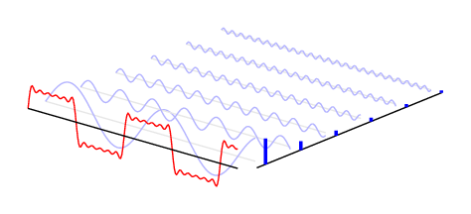
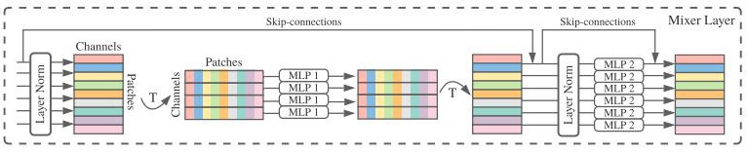
Attention-free?
Fnet: Mixing tokens with fourier transforms
Pay Attention to MLPs
MLP-Mixer: An all-MLP Architecture for Vision
https://arxiv.org/abs/2105.03824
https://arxiv.org/abs/2105.08050
https://arxiv.org/abs/2105.01601
Notes:
ViT2Vit -> CNN
Beyond Self-attention: External Attention using Two Linear Layers for Visual Tasks

Slide 45
How to Evaluate Document level Models?
Simple : Perplexity, classification over long documents
More focused:
Sentence scrambling
Final sentence prediction
Final word prediction
Composite benchmark containing several task: Long range arena
anthology.aclweb.org/J/J08/J08-1001.pdf
aclanthology.org/N16-1098.pdf
aclanthology.org/P16-1144.pdf
arxiv.org/pdf/2011.04006.pdf

Slide 46
Any Questions?

